Slide 1
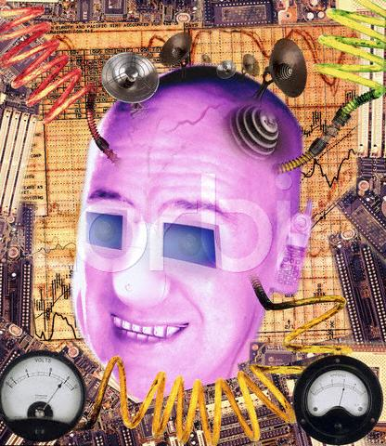
Robotics and Technology
Presentation adapted from Space Foundation Robotics/Nanotechnology 2009

Slide 2
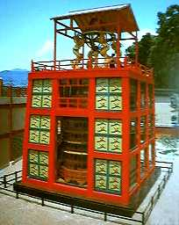
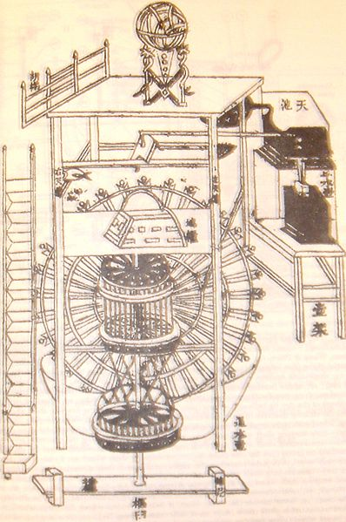
A robot is defined as:
A mechanical device that sometimes resembles a human and is capable of performing a variety of often complex human tasks on command or by being programmed in advance.
A machine or device that operates automatically or by remote control
Therefore, what device was considered the first robot and when was it developed?
A clock, ~ 270 BC
Presentation adapted from Space Foundation Robotics/Nanotechnology 2009

Slide 3
A Short History of Robots
Robot Timeline:
350 BC - the Greek mathematician, Archytas (ahr ky’ tuhs) builds a mechanical bird dubbed “the pigeon” that is propelled by steam.
270 BC - a Greek engineer named Ctesibus (ti sib’ ee uhs) made a pipe organ called a “hydraulis” and water clocks with movable figures. These clocks were the most accurate until the use of the pendulum in the 17th century.
1801 – Joseph Jacquard builds an automated loom that is controlled by a punch card. Punch cards are later used as an input method for some early 20th century computers.
http://prime.jsc.nasa.gov/ROV/history.html http://en.wikipedia.org/wiki/Archytas http://robotics.megagiant.com/history.html
Presentation adapted from Space Foundation Robotics/Nanotechnology 2009

Slide 4
1818 - Mary Shelley wrote "Frankenstein" which was about a frightening artificial life form created by Dr. Frankenstein.
1941 - Science fiction writer Isaac Asimov first used the word "robotics" to describe the technology of robots and predicted the rise of a powerful robot industry.
1942 - Asimov wrote "Runaround", a story about robots which contained the "Three Laws of Robotics"
1921 - The term "robot" was first used in a play called "R.U.R." or "Rossum's Universal Robots" by the Czech writer Karel Capek (chap’ ek). The plot was simple: man makes robot then robot kills man!
Presentation adapted from Space Foundation Robotics/Nanotechnology 2009

Slide 5
  1940 – Isaac Asimov produces a series of short stories about robots starting with “A Strange Playfellow” (later renamed “Robbie”) for Super Science Stories magazine. The story is about a robot bound to protect a child. It is later compiled into the volume, “I, Robot” in 1950.
  1948 - "Cybernetics", an influence on artificial intelligence research was published by Norbert Wiener.
1956 - George Devol and Joseph Engelberger formed the world's first robot company.
http://prime.jsc.nasa.gov/ROV/history.html http://en.wikipedia.org/wiki/Archytas http://robotics.megagiant.com/history.html
Presentation adapted from Space Foundation Robotics/Nanotechnology 2009

Slide 6
Three Laws of Robotics
by Isaac Asimov
  A robot may not injure a human, or, through inaction, allow a human being to come to harm.
  A robot must obey the orders it by human beings except where such orders would conflict with the First Law.
  A robot must protect its own existence as long as such protection does not conflict with the First or Second Law.
  He later adds the “Zeroth Law”. A robot may not injure humanity, or, through inaction, allow humanity to come to harm.
Presentation adapted from Space Foundation Robotics/Nanotechnology 2009

Slide 7
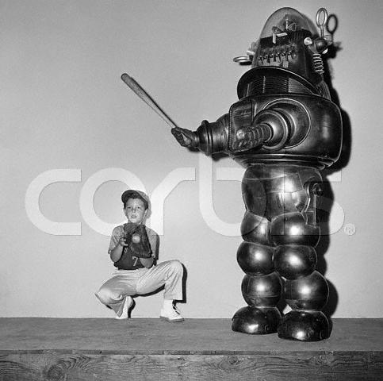
1977 – Star Wars is released. George Lucas introduces watchers to R2-D2 and C-3PO, and the strongest image of a human future with robots. It inspires a generation of researchers.
1979 - The Standford Cart crossed a chair-filled room without human assistance. The cart had a TV camera mounted on a rail which took pictures from multiple angles and relayed them to a computer. The computer analyzed the distance between the cart and the obstacles.
Presentation adapted from Space Foundation Robotics/Nanotechnology 2009

Slide 8
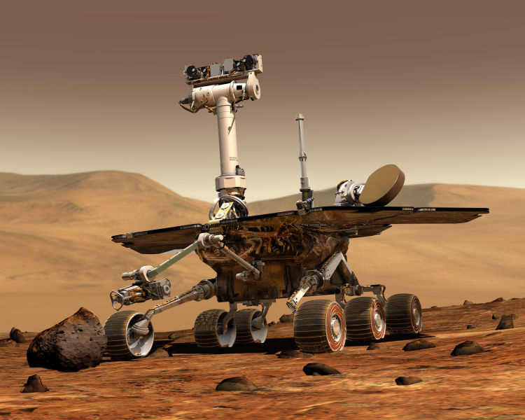
1997 –Pathfinder lands on Mars.
1997 – The first node of the ISS is placed in orbit using a robotic arm.
1998 – Tiger Electronics introduces Furby. It can react to its environment and communicate using over 800 phrases.
2004 – The Mars Exploration Rovers Spirit and Opportunity land on Mars and prove that Mars was once covered with water.
Image courtesy of NASA
Presentation adapted from Space Foundation Robotics/Nanotechnology 2009

Slide 9
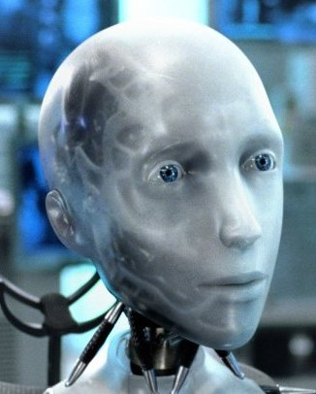
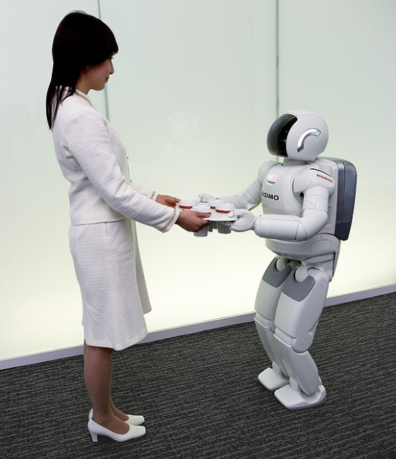
2004 – I, Robot, new version of robots trying to take over the world.
2005 - Honda debuts new Asimo robot that can complete office tasks.
Presentation adapted from Space Foundation Robotics/Nanotechnology 2009

Slide 10
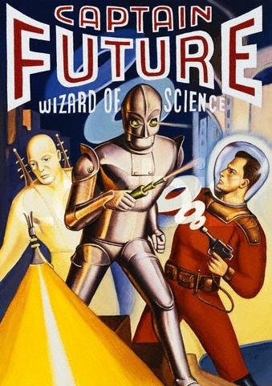
Why are robots important in today’s society?
Presentation adapted from Space Foundation Robotics/Nanotechnology 2009

Slide 11
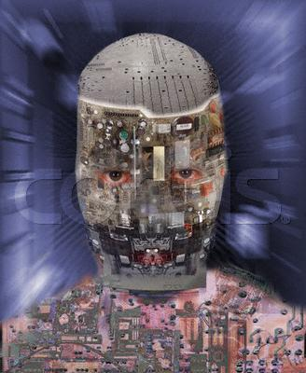
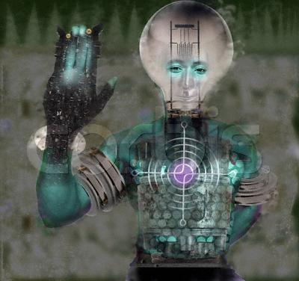
ROLES AND JOBS OF ROBOTS
Computer Assisted Manufacturing
Military
Medical
Space Exploration
Personal
Presentation adapted from Space Foundation Robotics/Nanotechnology 2009

Slide 12
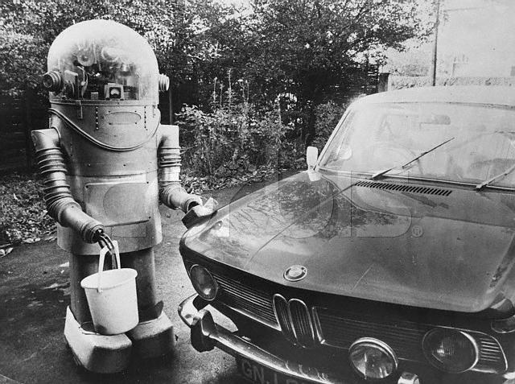
Computer Assisted Manufacturing
Car Industry
General Packaging
Mail Processing
etc.
Presentation adapted from Space Foundation Robotics/Nanotechnology 2009

Slide 13
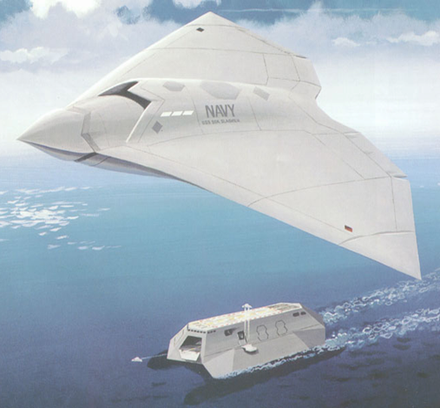
MILITARY
Computer GPS guided bombs “smart bombs”.
Movement of troops, weapons, etc.
Advancements in war weapons, aircraft, artillery, naval ships, etc.
Presentation adapted from Space Foundation Robotics/Nanotechnology 2009

Slide 14
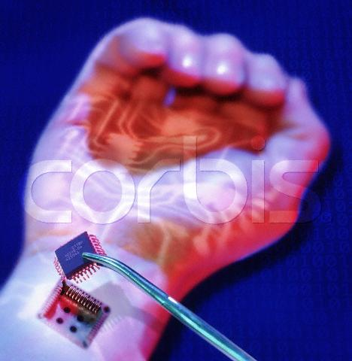
MEDICAL
Prosthetic limbs
Pacemakers
Dialysis Machines
Heart rate monitors
Blood Pressure Machines
etc.
Presentation adapted from Space Foundation Robotics/Nanotechnology 2009

Slide 15
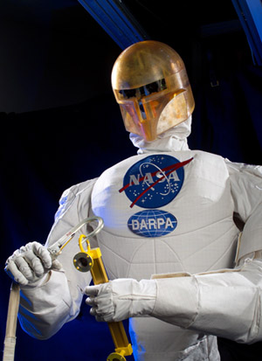
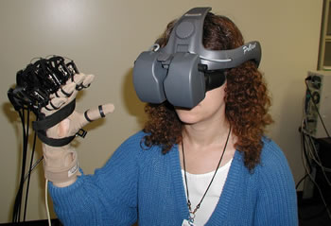
Space Exploration
Robonaut
Developed in 2004
Humanoid robot to assist astronauts
Controlled by Virtual Reality
Stereoscopic vision
Dexterous hands
Several configurations
Presentation adapted from Space Foundation Robotics/Nanotechnology 2009

Slide 16
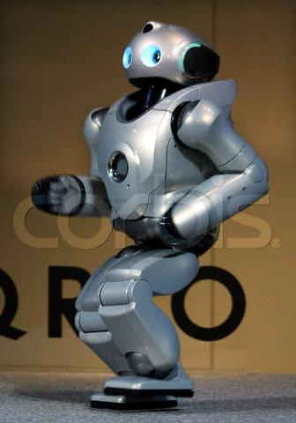
Personal
Fax Machines
Computers
Refrigerators
Blenders
Watches
GPS Receivers
etc.
Presentation adapted from Space Foundation Robotics/Nanotechnology 2009

Slide 17
ADVANTAGES, DISADVANTAGES, AND FUTURE CONCERNS OF ROBOTS
PROS:
Each machine “robot” helps our population greatly via technology advances and improvements in the overall health of our society.
Medicinal advancements
Labor intensive activities are decreased due to machines “robots”.
Mathematical & statistical computations.
Robots can go and do things that are unsafe for humans (Example: bomb disarming robots, space probes, etc..
Presentation adapted from Space Foundation Robotics/Nanotechnology 2009

Slide 18
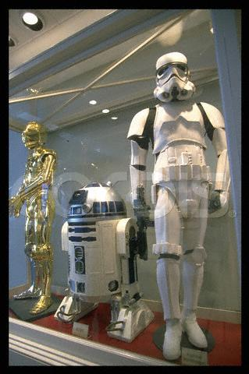
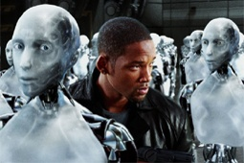
CONS & Future concerns:
Loss of jobs due to replacement by robots.
War of the Worlds?
Presentation adapted from Space Foundation Robotics/Nanotechnology 2009

